Slide 1
3rd Health Programme 2014-2020
Call 2018: Projects,
Joint Action nomination,
New online submission system
Cinthia Menel Lemos - Scientific Project Officer
Sarajevo, 02 February 2018

Slide 2
2018 Calls for proposals for PROJECTS (PJ)

Slide 3
What does the 3rd Health Programme say regarding co-funding of projects?
Grant may be awarded to fund:
actions having a clear Union added value explicitly provided for
duly justified in the annual work programmes
co- financed by other legally established organisations:
public sector bodies: research and health institutions, universities and higher education establishments
non-governmental bodies
private bodies

Slide 4
What is a project?
A particular method of organising work that differs from standard business operational activities:
Different from routine activities:
does not involve the application of implicit or explicit procedures existing in the organisation to regulate day-to-day work
Different from improvisation:
more effective, but also more time-consuming
entails a level of uncertainty or risk
Particularly useful to introduce innovations, address new challenges or find solutions for problems for which the existing procedures and routines do not accommodate

Slide 5
Scaling up integrated care € 3 650 000
EURIPID collaboration € 300 000
ORPHACODE € 750 000
European Reference Networks € 13 800 000
Implementation of best practices
to promote health and prevent
non-communicable diseases and
to reduce health inequalities € 2 350 000

Slide 6
Calls for proposals for projects - 2018
Call opened: 25 January 2018
Call closure: 26 April 2018
Submission through the electronic submission system
EUR 4 700 000 Euros available for Projects

Slide 7
Calls for proposals for projects - 2018
https://ec.europa.eu/research/participants/portal/desktop/en/opportunities/3hp/calls/hp-pj-2018.html
Call opened: 25 January 2018
Call closure: 26 April 2018
Submission through the electronic submission system
EUR 4 700 000 Euros available for Projects

Slide 8
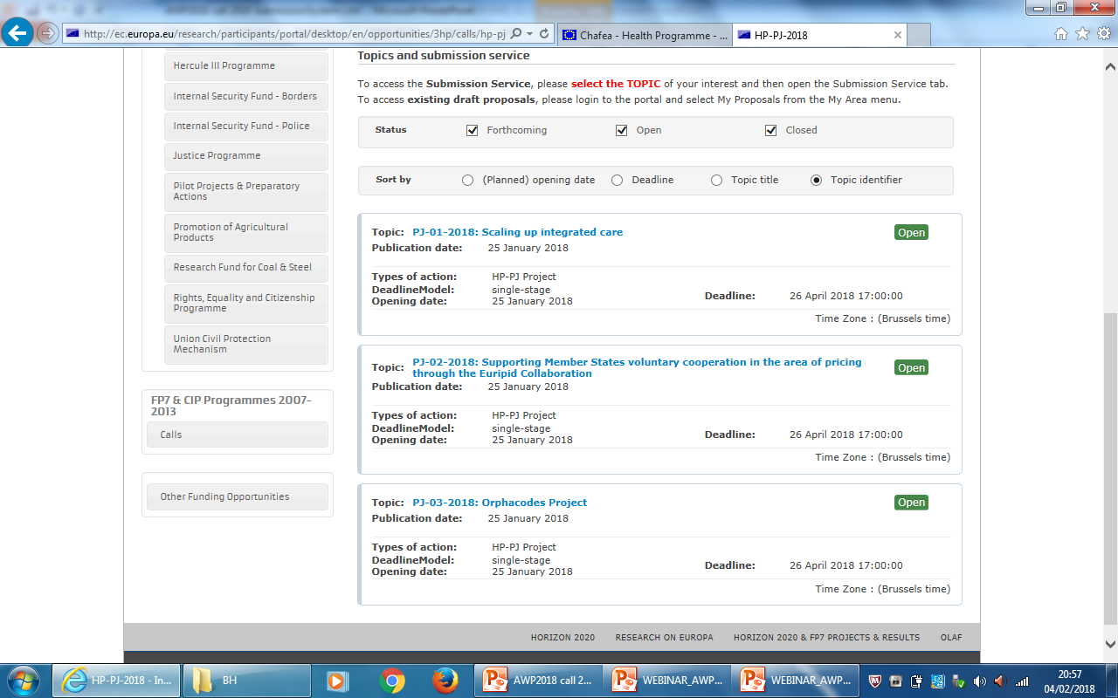

Slide 9
Project co-funding
60% EC funding of the total eligible cost +
40% partners own contribution
80% - if exceptional utility,
20% partners own contribution
The co-funding rate is valid for both the consortium level and for each partner as well

Slide 10
Exceptional utility
Co-funding may be up to 80% when the two (2) criteria are fulfilled:
At least 60 % of the total budget of the action is used to fund staff
At least 30% of the budget of the proposed action is allocated to Member States whose gross national income (GNI) per inhabitant is less than 90 % of the Union average.
It is your responsibility to ensure that the proposal complies with the criteria and to justify in the proposal

Slide 11
Criteria to evaluate the proposals
Eligibility criteria
Exclusion criteria
Selection criteria
Award criteria

Slide 12
Eligibility criteria
Applicants must be legally established in one of the 28 EU Member States, EEA/EFTA (Norway and Iceland), and other countries (Serbia, Bosnia-Herzegovia and Moldova).
A project proposal must be submitted by at least 3 different legal entities from 3 different eligible countries.
The only eligible activities are those listed in section 2.1 "Grants for projects" in the Annex to the work programme 2018.
The co-funding is meant for a future project, running projects cannot be supported.

Slide 13
Eligibility criteria
For British applicants:
Please be aware that eligibility criteria must be complied with for the entire duration of the grant. If the United Kingdom withdraws from the EU during the grant period without concluding an agreement with the EU ensuring in particular that British applicants continue to be eligible, you will cease to receive EU funding (while continuing, where possible, to participate as collaborating partner) or be required to leave the project on the basis of Article 34.3 of the grant agreement.

Slide 14
Exclusion criteria
Exclusion from participation:
being bankrupt,
convicted of an offence concerning professional conduct,
guilty of grave professional misconduct
not in compliance with their obligations relating to the payment of taxes
Exclusion from granting procedure:
conflict of interest
guilty of misrepresenting the information required by the Agency

Slide 15
Selection criteria
Financial viability
Not if < 100 000€ EU co-funding or if public
If > 750 000€ -> attach audit report
Self-check must be performed
If the self-check result is "weak" do not be discouraged from applying!
Operational capacity
Self-declaration
Provide information on capacity

Slide 16
Award criteria-I
 | Maximum points | Threshold | Threshold in % of max. points
1 – policy relevance | 10 | 7 | 70%
2 – technical quality | 10 | 6 | 60%
3 – management quality | 10 | 6 | 60%
4 – budget adequacy | 10 | 6 | 60%
TOTAL | 40 | 25

Slide 17
Award criterion 1 - Policy and contextual relevance
Sub-criteria:
Relevance of the contribution to meeting the objectives and priorities defined in the annual work plan of the 3rd Health Programme, under which the call for proposals is published,
Added value at EU level in the field of public health,
Pertinence of the geographical coverage of the proposals is high,
Consideration of the social, cultural and political context.

Slide 18
Award criterion 2 - Technical quality
Sub-criteria:
Quality of the evidence base,
Quality of the content,
Innovative nature, technical complementarity and avoidance of duplication of other existing actions at EU level,
Quality of the evaluation strategy,
Quality of the dissemination strategy and plan.

Slide 19
Award criterion 3 - Management quality
Sub-criteria:
Quality of the planning and appropriate task distribution to implement the project,
Relevance of the organisational arrangements, including financial management,
Quality of the partnership.

Slide 20
Award criterion 4 - Overall and detailed budget
Sub-criteria:
Relevance and appropriateness of the budget,
Consistency of the estimated cost per applicant and the corresponding activities,
Realistic estimation of person months per work package
The budget allocated for evaluation and dissemination is reasonable.

Slide 21
Evaluation of proposals
2. Financial &
organisational
analysis
check
compliance with
the
selection criteria
1. Screening
check
completeness,
allocation to
evaluators
3. Evaluation of compliance
with award criteria
External evaluators
4.Consensus
meeting
Chaired by a
project officer.
Outcome:
consensus
evaluation report
5.Evaluation committee
Based on ranking:
a) Ensure compliance with criteria
b) Exclude potential duplication
c) Decide on funding based on proposed
co-funding and available budget
7.Adaptation
8.Award decision
grant agreement

Slide 22
Grants for Joint Actions 2018 What is new?

Slide 23
2018 AWP: what is new for JA
Direct grant/ negotiated procedure = > all participants have to be nominated first (no open call!)
Previously: several participating entities from each Member State/ participating country
From 2017: Limited to one participating entity per JA/ per Member State or participating country
2018: : one participating Competent Authority/per Member State or participating country

Slide 24
The role of the MS
To nominate CA participants prior to Chafea invitation to prepare the proposal
Participants
Competent authority (national or regional level), that is the eligible body to participate on behalf of the respective Member State/ region and under its responsibility in the relevant action

Slide 25
How much co-funding?
EU contribution is 60 % of the total eligible cost;
In cases of exceptional utility, it is 80 %.
The co-funding rate applies both to the consortium and individual beneficiary levels
Who can participate?
Country eligibility – EU 28 and EEA (Norway and Iceland)
Serbia, Moldova and Bosnia-Herzegovina

Slide 26
Exceptional utility criteria
At least 30 % of the budget of the proposed action is allocated to MS whose gross national income (GNI) per inhabitant is less than 90 % of the Union average.
This criterion intends to promote the participation from MS with a low GNI.
Bodies from at least 14 participating countries participate in the action, out of which at least four are countries whose GNI per inhabitant is less than 90 % of the Union average.
This criterion promotes wide geographical coverage and the participation of MS authorities from countries with a low GNI.

Slide 27
Entities affiliated to the nominated competent authorities ('Affiliated entities')
These are organisations that have a distinct legal personality, but are linked to the nominated competent authority.
Affiliated entities receive co-funding through the participating competent authority.
While they do not sign the grant agreement, they actively contribute to the implementation of the action.

Slide 28
Other types of participation (without the preliminary submission of a nomination)
Subcontractors
for the purpose of providing special expertise to the joint action.
Collaborating stakeholders
These may significantly increase the technical and scientific content of the joint action, as well as its relevance for different users in the Union
It can also ensure appropriate representation of civil society organizations active in the relevant health fields at EU level.

Slide 29
Deadline for NOMINATION of competent authority
***** 13 March 2018 *****

Slide 30
Electronic Grant preparation

Slide 31
3rd Health Programe use the Electronic Exchange Systems
Aligned with the HORIZON 2020 Programmes
Electronic Submission
Electronic Evaluation
Electronic Grant preparation and monitoring
Electronic Signatures
Model Grant Agreement, Payments, Cost structure, simplifications

Slide 32
Applying for funding
Find
a Call
Find
partners
Register an organisation
Submit a proposal
Evaluation & Grant signature
Evaluation of proposals
Grant preparation
Grant signature
Grant Management
Reports
Dissemination of results
Amend-ments
Audits & certifications
Experts opinion
Expert registration
Contracting & payment
Expert roles & tasks

Slide 33
New system = new terminology (1)
The Participant Portal (PP) is the website hosting the information about funding for the third Health Programme (2014-2020) and Horizon 2020 programmes http://ec.europa.eu/research/participants/portal/desktop/en/home.html
The ECAS account is the European Commission's Authentication Service. It is the system for logging on to a whole range of websites and online services run by the Commission.
The Beneficiary Register is the European Commission's online register of the beneficiaries participating in EU Programmes, such as Horizon 2020 programmes, the Health and Consumers Programmes and others.

Slide 34
New system = new terminology (2)
The Participant Identification Code (PIC number) is a 9-digit participant identification code, unique, received upon completing the registration of the entity online
The LEAR (Legal Entity Appointed Representative) is the appointed representative within the beneficiary organisation.
He/she is authorized to sign the grant agreement and action's documents on behalf of the organisation

Slide 35
Submission Procedure steps
Find your call and priority
Find project partners
Create a ECAS user account
Register an organisation (PIC number)
Submit a proposal: Administrative Proposal (Form A) and Technical Narrative (Form B)

Slide 36
https://ec.europa.eu/research/participants/portal/desktop/en/opportunities/3hp/calls/hp-pj-2018.html
Chafea website
http://ec.europa.eu/chafea
http://ec.europa.eu/research/participants/portal/ desktop/en/home.html
Navigation
pane

Slide 37
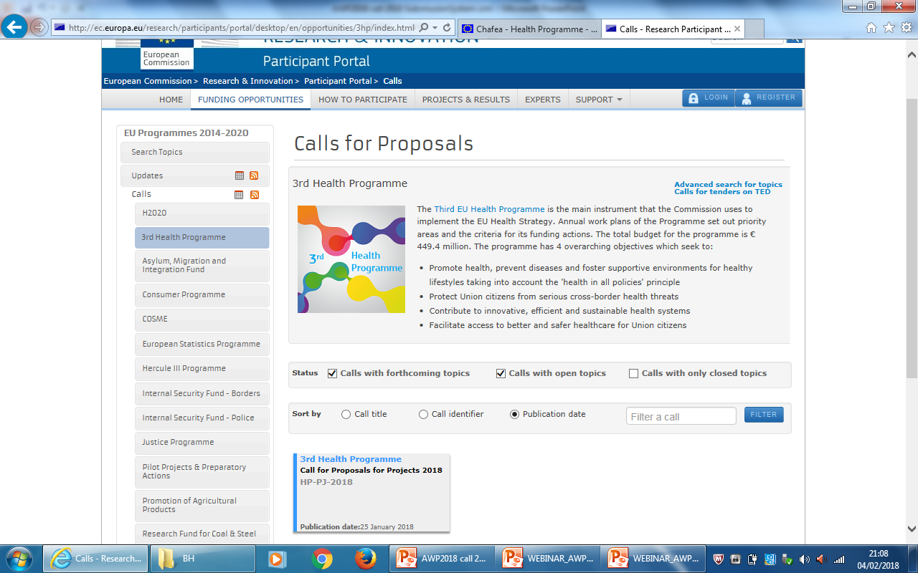
http://ec.europa.eu/research/participants/portal/ desktop/en/home.html
Navigation pane
Text announcement

Slide 38
Structure of the Project Proposal
Administrative
Part
Technical Narrative
Part B,
includes Budget
Audit report

Slide 39
Electronic submission of project (Joint Action) proposals
Via participant portal
Find a call -> each of the calls is published separately
Administrative part = part A
Technical part = part B

Slide 40
Part A
Overview budget per partner – need to establish this before filling part A !
Statements to be accepted, e.g. on financial viability
Financial self-check to be performed by each applicant (private organisations)
If "weak" -> do not be discouraged to send a proposal
Other statements on exclusion criteria, operational capacity etc.

Slide 41
Technical Part = Part B
Maximum 80 pages – free text & tables & charts
50 pages for the technical description
30 pages for the budget tables
One table per partner
Overview table with person months per deliverable

Slide 42
Electronic Grant preparation
Grant preparation online (back and forth principle between agency and beneficiaries)
Electronic signature by LEAR (Legal entity authorized representative) – no paper copies of grant agreement
Partners join the agreement after signature (accession)
Monitoring and reporting online: Deliverables, Payment requests, Reports, etc.

Slide 43
New Grant Agreement rules
New model grant agreement aligned to H2020 procedures
Interim Payment instead of 2nd pre-financing, require supporting documents
Simplified cost structure (Staff, Other Costs, Subcontracting),
Budget shifts allowed without amendment
All partners sign the grant agreement
Consortium agreement mandatory
Read the Grant Agreement (GA) !

Slide 44
Tips
Tutorials
Search partner tool

Slide 45
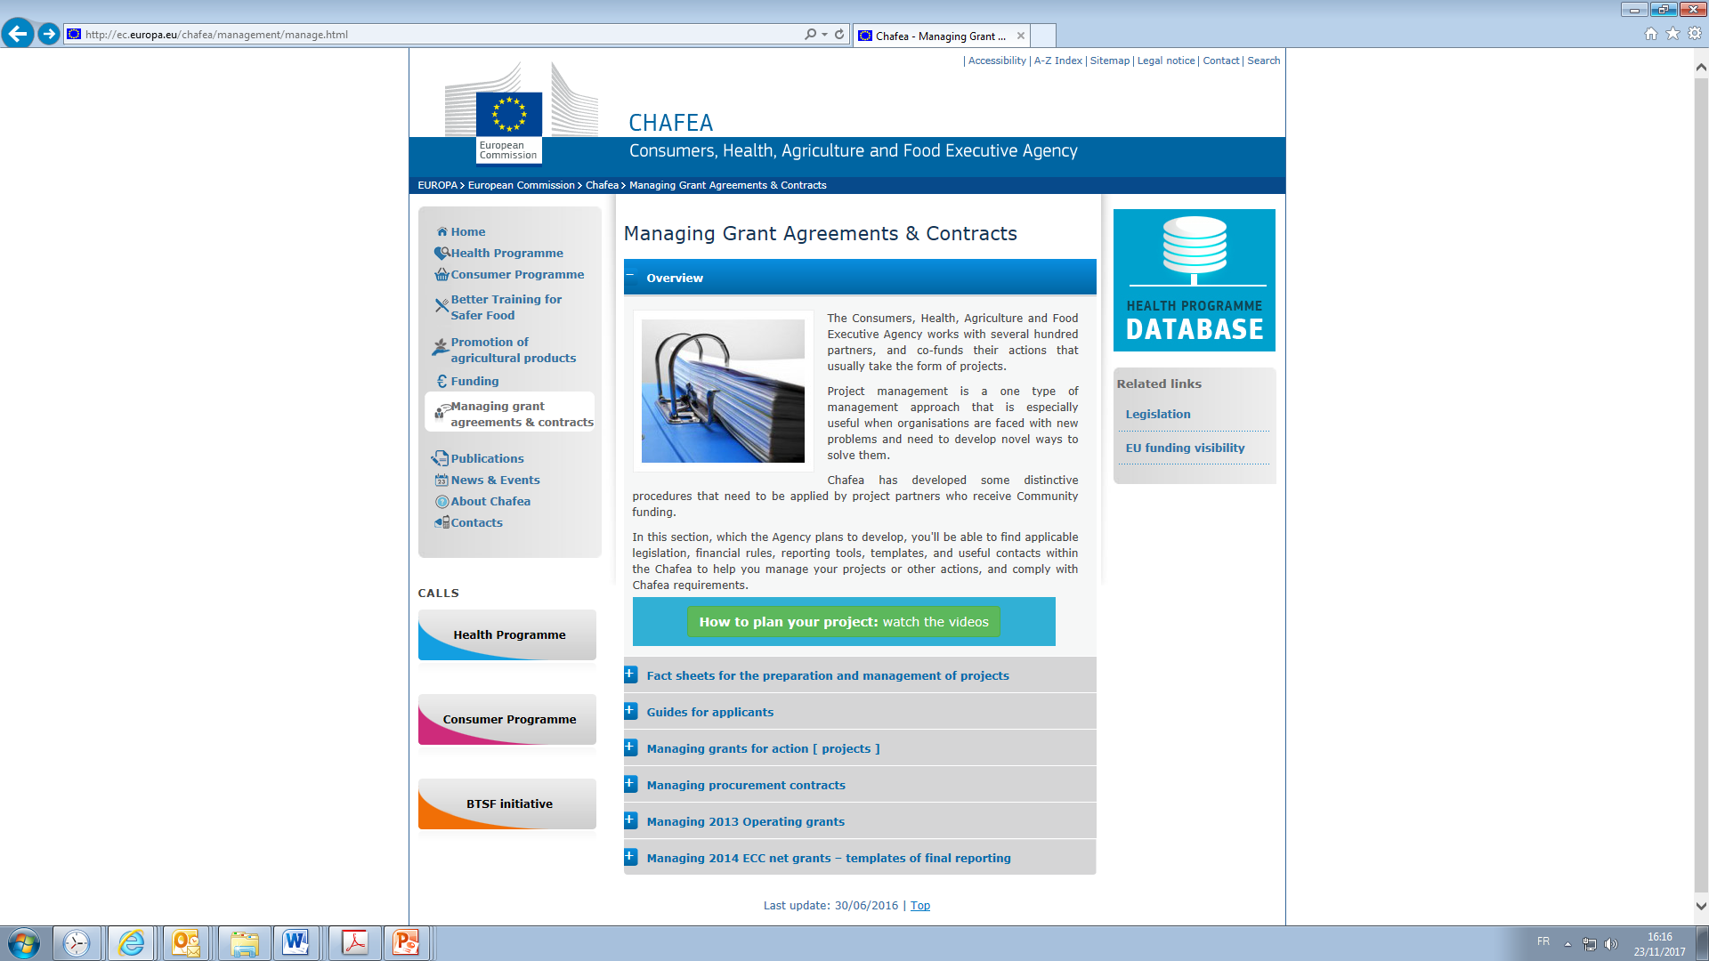
Notes:
http://ec.europa.eu/chafea/health/projects-videos_en.html

Slide 46
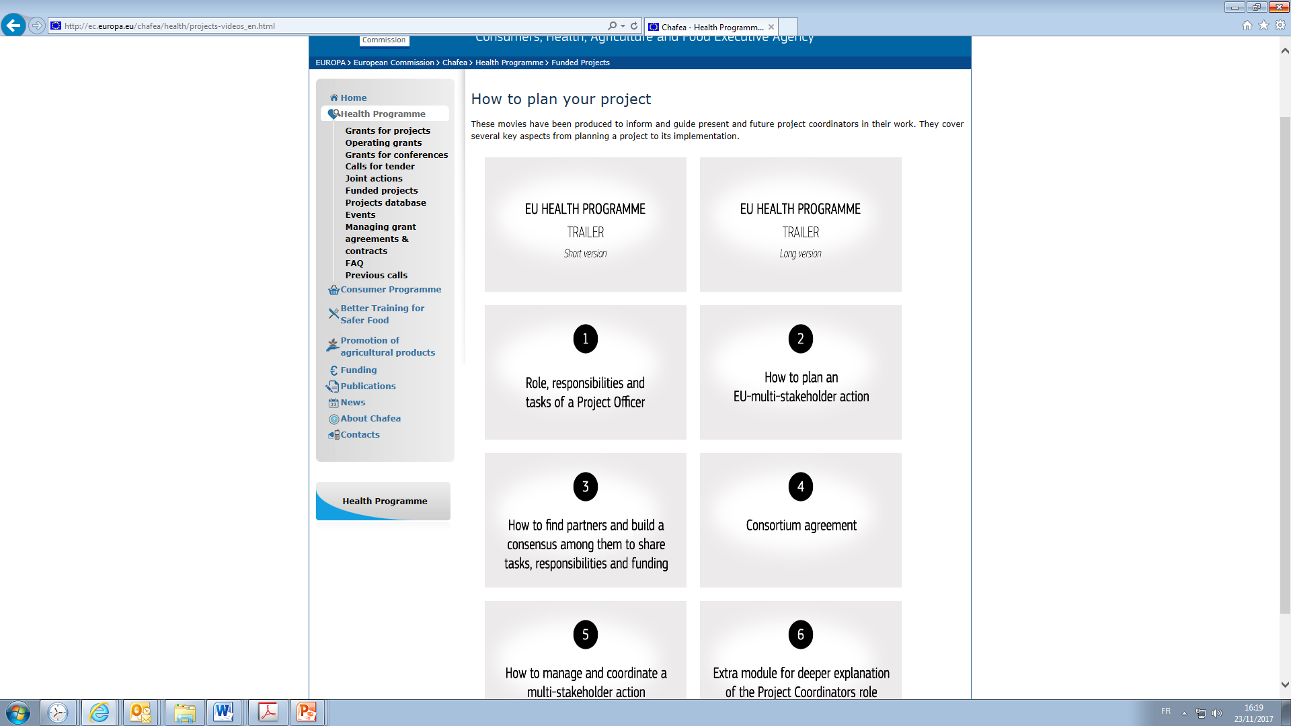
http://ec.europa.eu/chafea/health/projects-videos_en.html
Notes:
Chafea has developed a series of tutorials on 6 topics to explain simply project management tailored for HP

Slide 47
Any questions?
Chafea helpdesk:
General questions, call for projects and Framework partnership agreement (FPA) (CHAFEA-HP-CALLS@ec.europa.eu)
Joint Actions: CHAFEA-HP-JA (CHAFEA-HP-JA@ec.europa.eu)
CHAFEA-HP-TENDER (CHAFEA-HP-TENDER@ec.europa.eu)

Slide 48
Thank you for your attention!
Cinthia Menel Lemos Scientific Project Officer European Commission Consumers, Health, Agriculture and Food Executive Agency (Chafea) Health Unit cinthia.menel-lemos@ec.europa.eu http://ec.europa.eu/eahc/

Slide 49
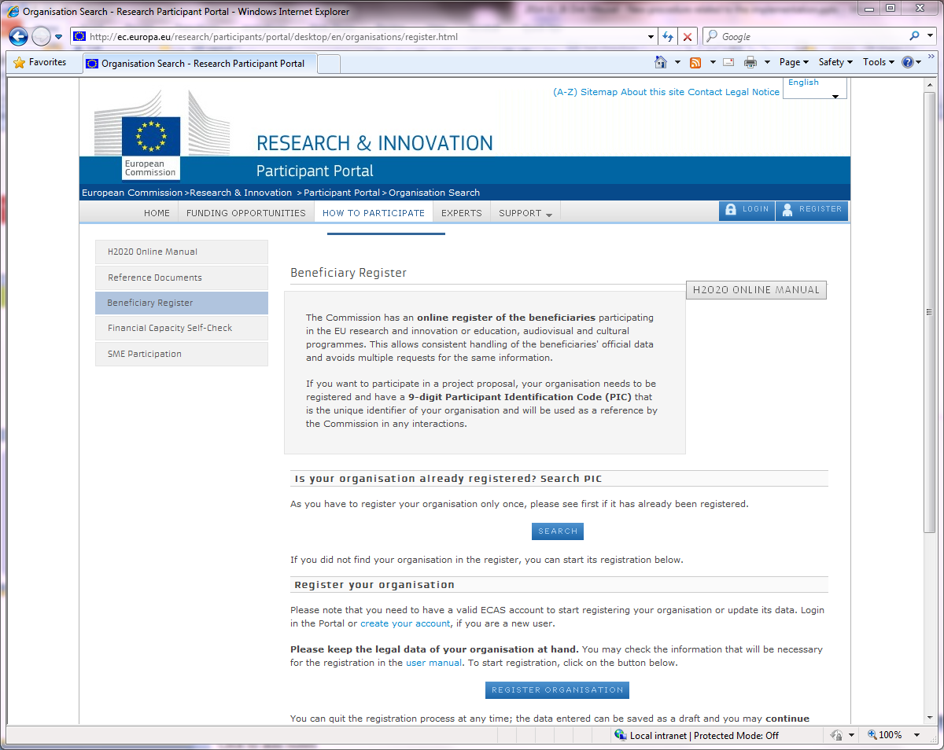
Make sure, you and your partners' organisations are registered.
http://ec.europa.eu/research/participants/portal/desktop/en/ organisations/register.html
Legal Entity
Registration

Slide 50
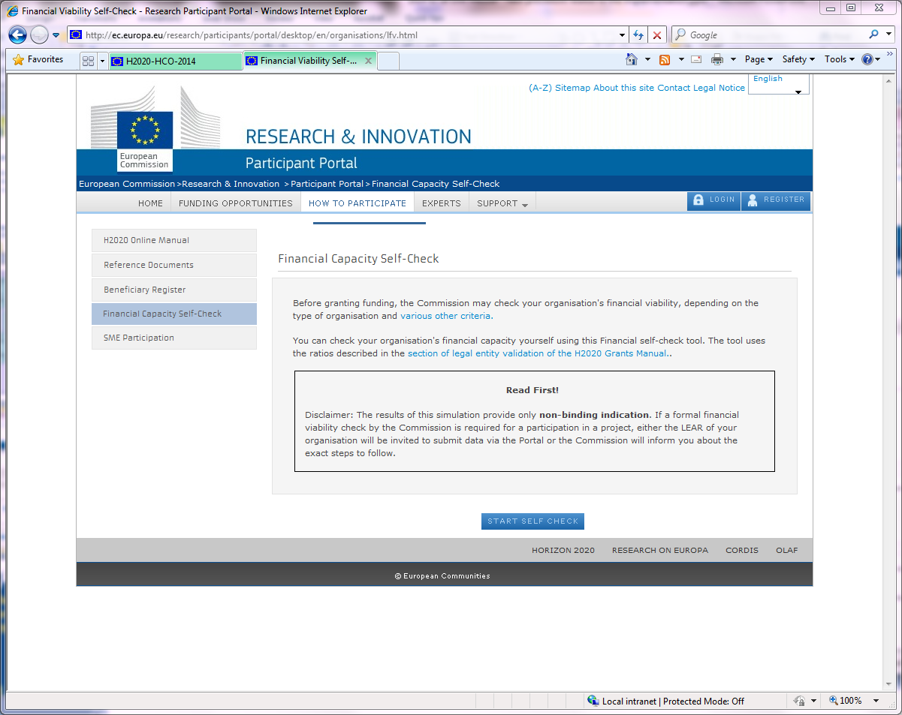
Do the Financial Capacity Self Check
http://ec.europa.eu/research/participants/portal/desktop/en/ organisations/lfv.html
Capacity
Self-Check

Slide 51
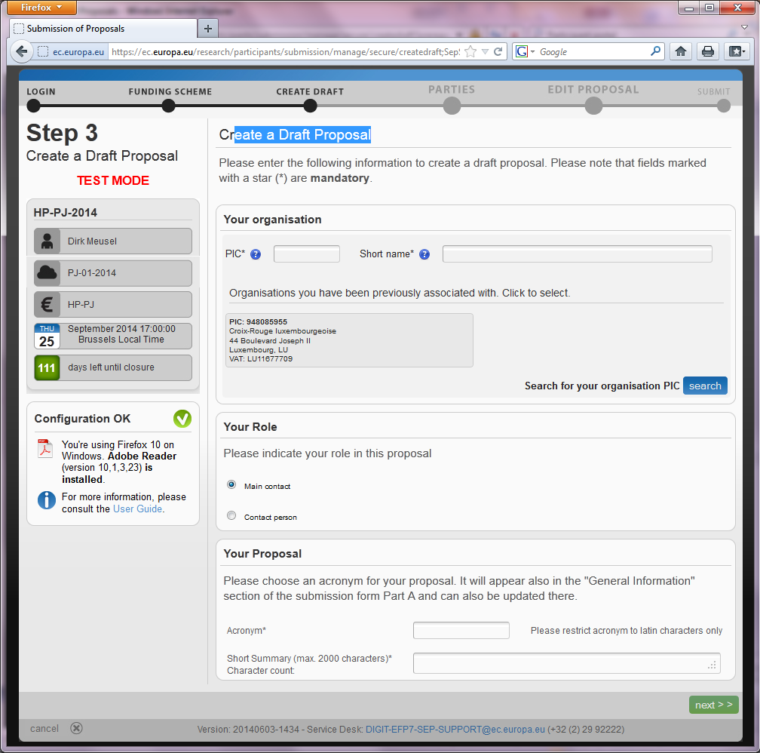
Create a Draft Proposal
Search your PIC
Put Acronym and Summary
Next

Slide 52
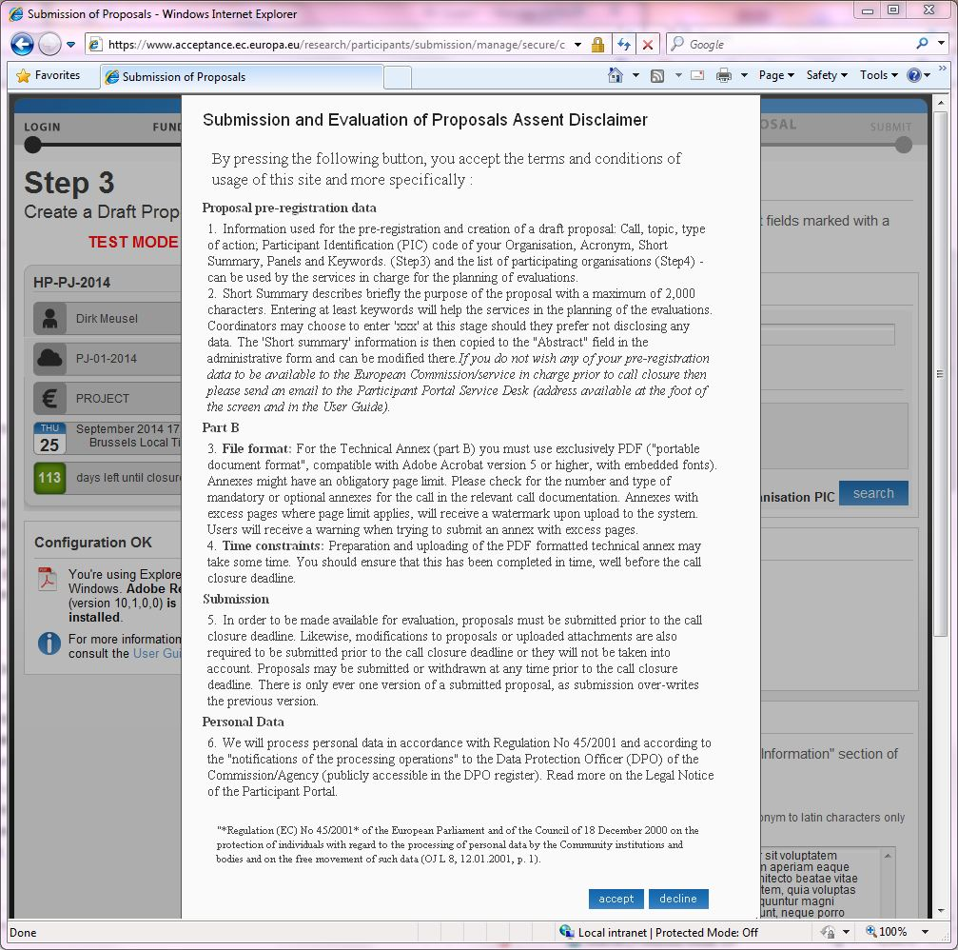
Accepting creates draft proposal

Slide 53
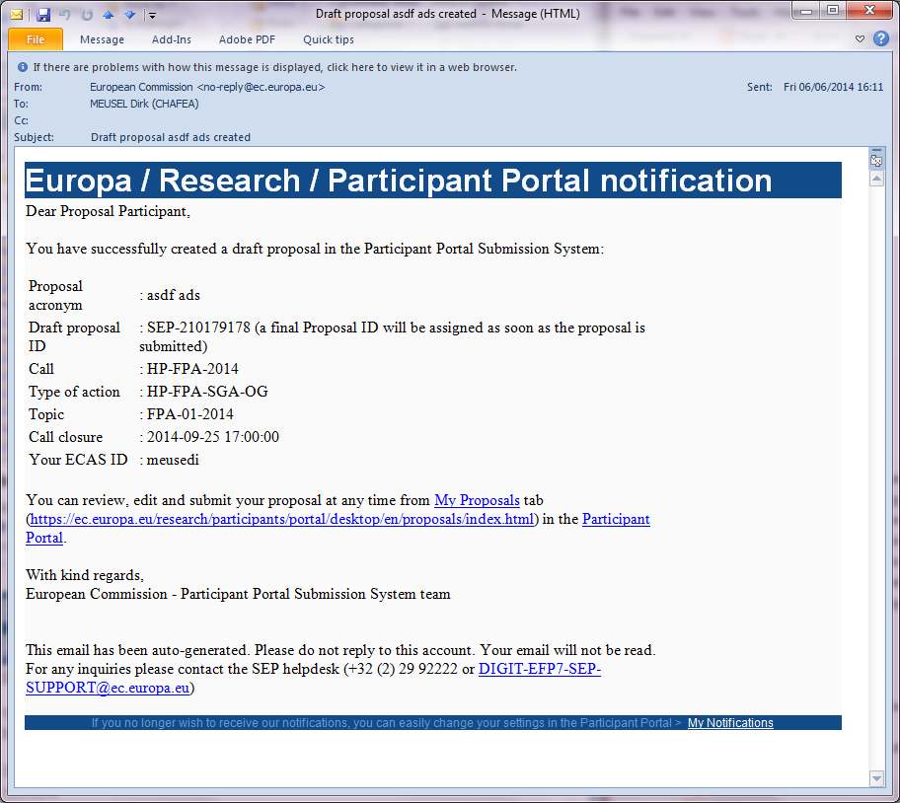
Confirmation by e-mail
Confirmation by email,
Including "draft proposal ID"

Slide 54
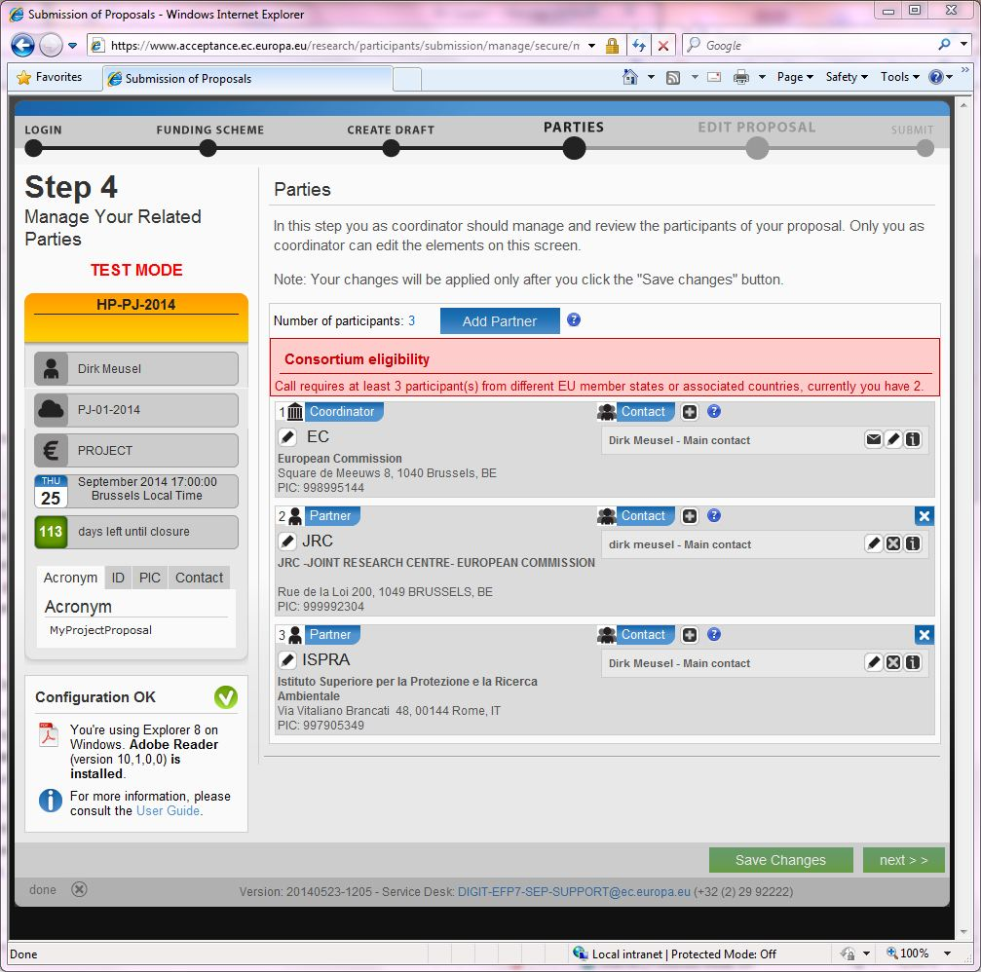
Choose your partners
Partners
Contacts

Slide 55
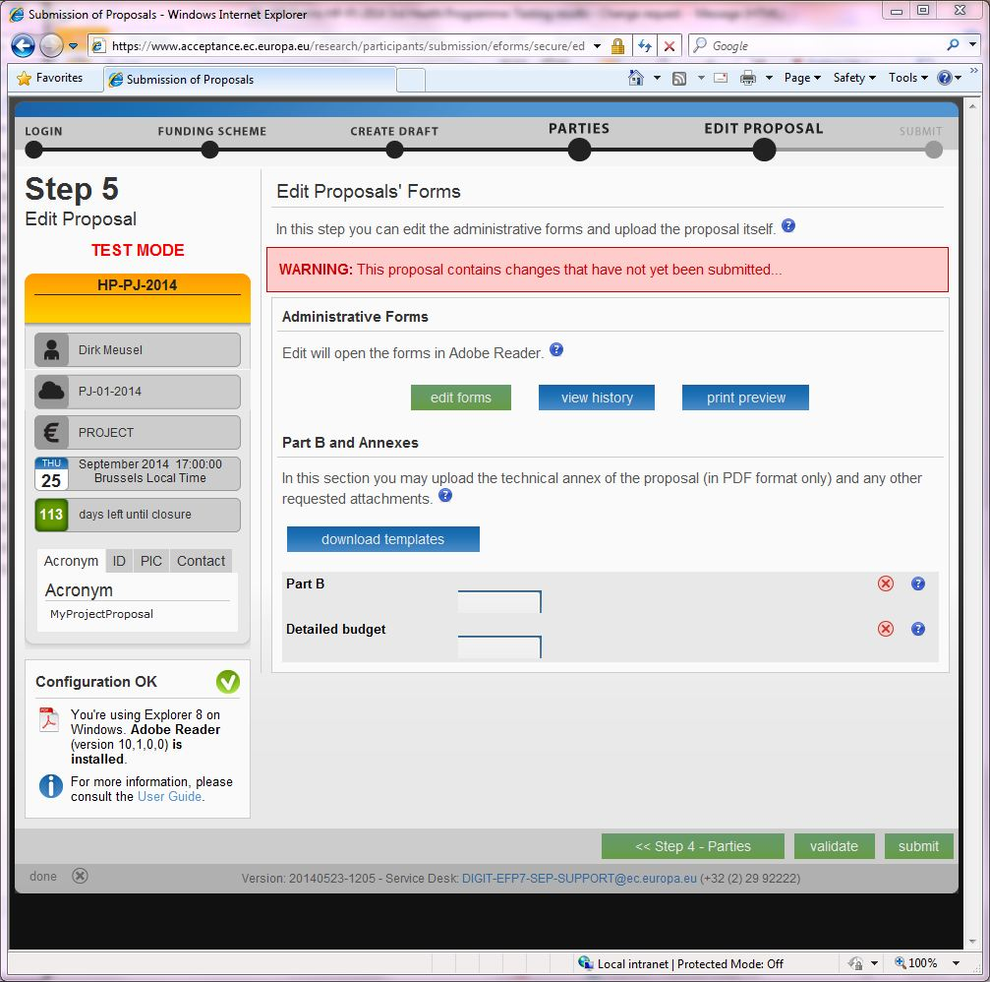
Main screen
Administrative
Forms
Downloads
Part B upload

Slide 56
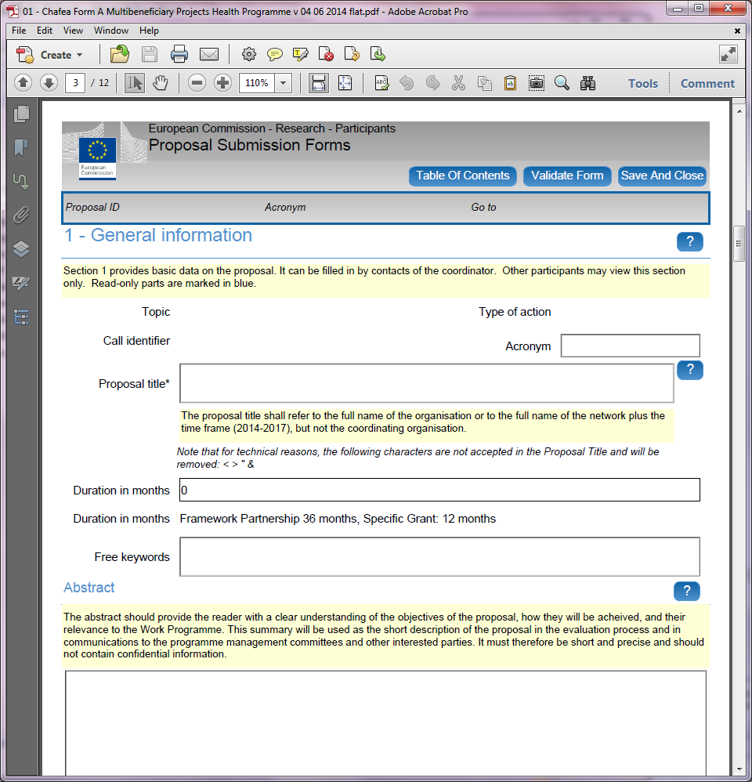
PDF-based Administrative Form
Online help throughout the form

Slide 57
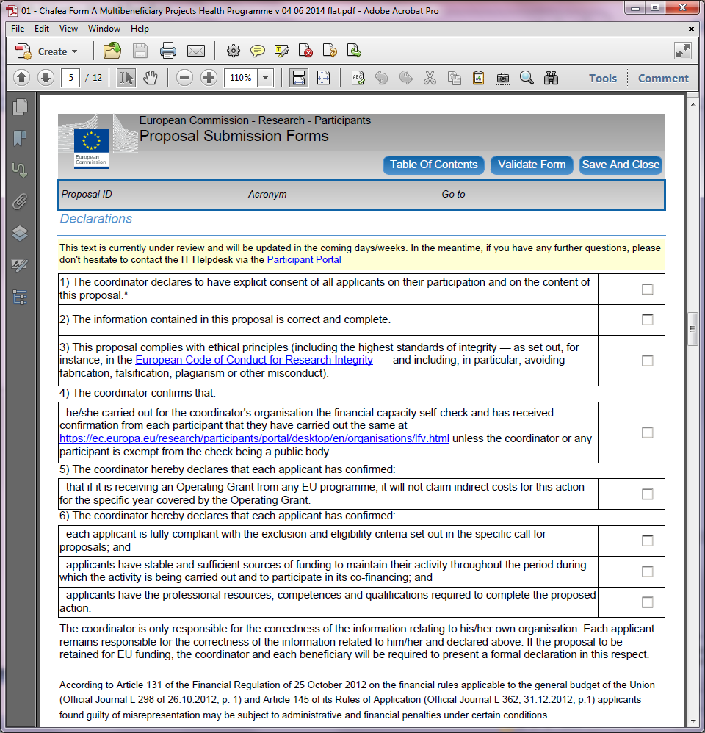
Declarations Section

Slide 58
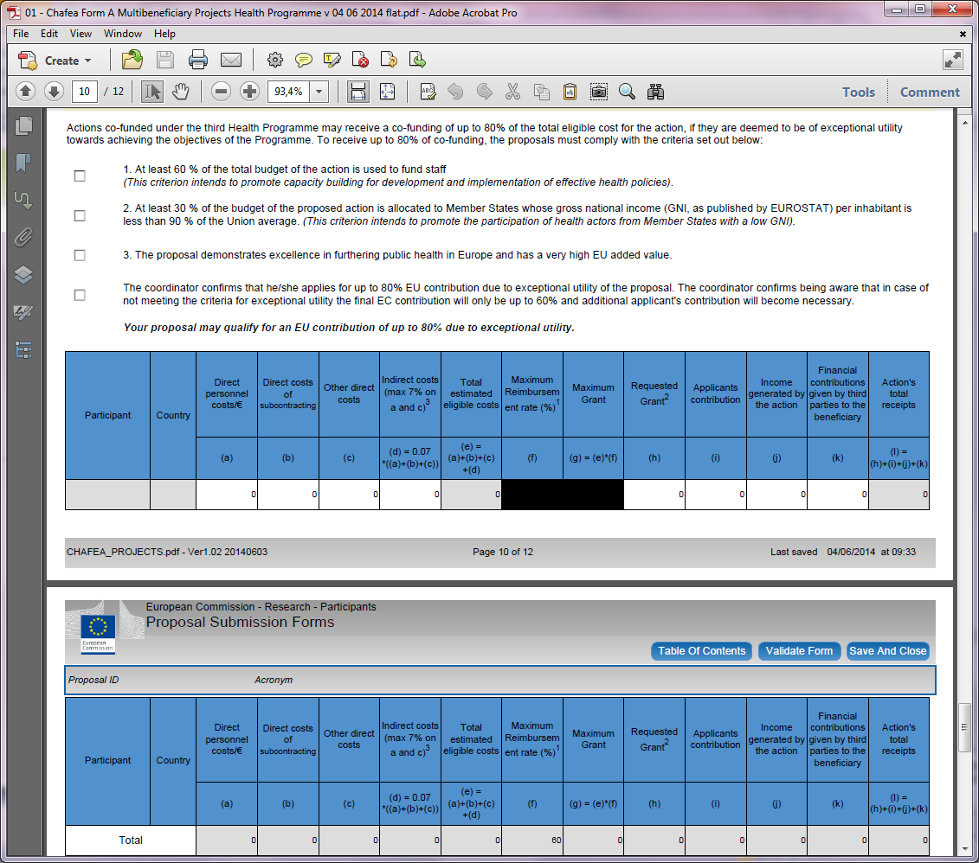
Simplified Budget Table

Slide 59
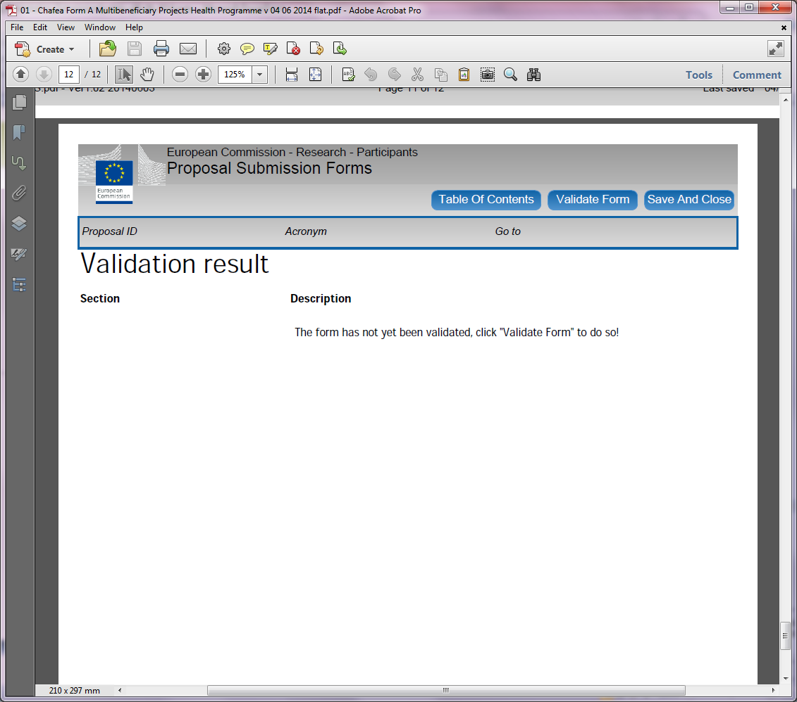
Declarations Section
Validation

Slide 60
Main screen
Administrative
Forms
Downloads
Part B upload

